Slide 1
Adsorption of Toxic Metals and Metalloids onto Engineered Nanomaterials
John Lee
Dr. Reyes Sierra
The University of Arizona
Arizona State University Symposium
Tempe, Arizona
April 22nd 2017

Slide 2

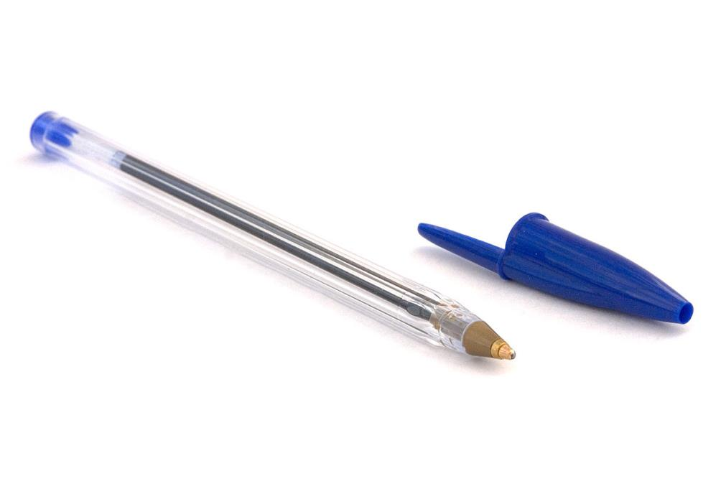
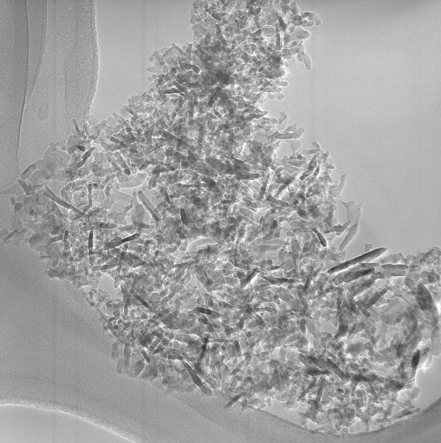
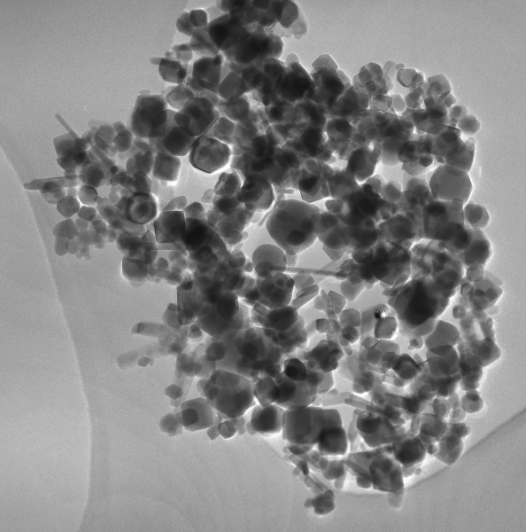
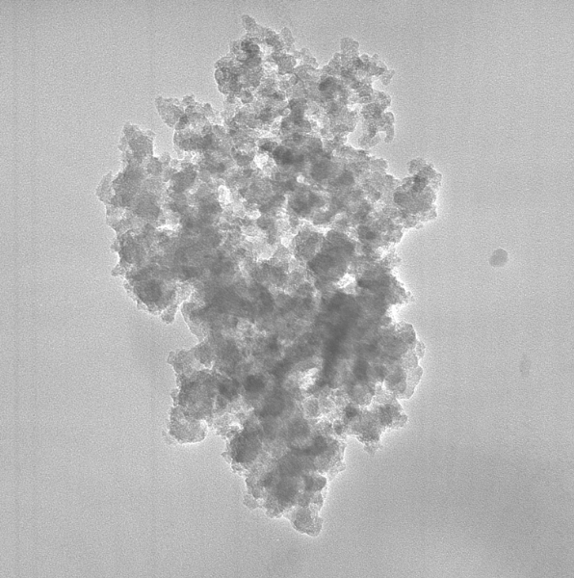

What Are Engineered Nanoparticles (ENPs)?
NPs are particles between 1 and 100 nanometers in size
ENPs are intentionally manufactured to fulfill this size and other technical criteria
Al₂O₃
Fe₂O₃
SiO₂
Mount Everest
1 mm
100 nm
Source: wikipedia.org
166 nm
125 nm
Source: TheOutline.com
Notes:
-what are nanoparticles?
-size
-perspective: bic cristal pen, most popular pen, point on pen is 1 mm, comparing average NP of 20 nm to pen tip = length of pen to height of mt. everest
-not everything exists in nature at these sizes
-ENPs are artificially created to be within these sizes, fulfill other criteria desired by the industry
-why are NPs desirable? Size affects function, reactivity, → lead to next slide, where they’re used

Slide 3
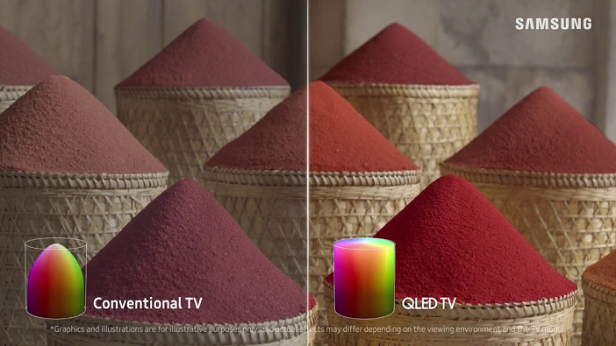
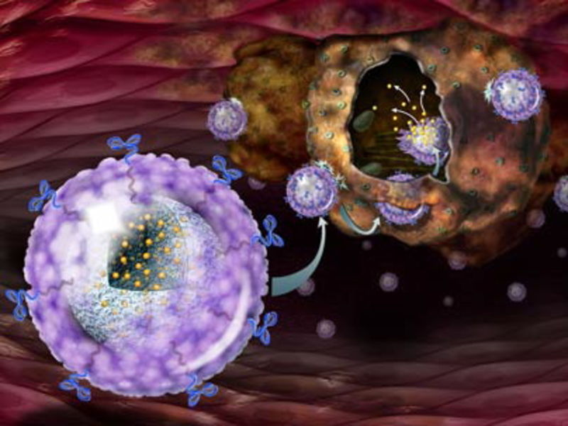



Where Are ENPs Found?
Catalysts
Sunscreen
OLED and quantum dot displays
Nanomedicine
Source: forbes.com
Source: Telegraph.co.uk
Source: Photos-Public-Domain.com
Source: samsung.com
Source: ias.org.in

Slide 4
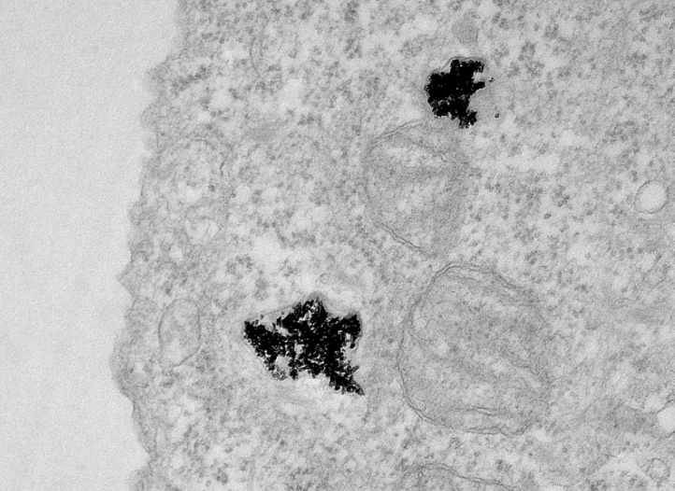
What’s The Issue?
Potential for metals to adsorb onto ENPs
Adsorption will change where metal contaminants end up
  Environment
  In your body
CeO₂ Nanoparticles
Metal contaminants
Nanoparticle
Lysosome
500 nm
Notes:
Toxic risks of heavy metals
-Arsenic is one of the most highly toxic water pollutants
-Few studies exist on the toxicity of gallium and indium
Picture
-CeO2 in cell

Slide 5
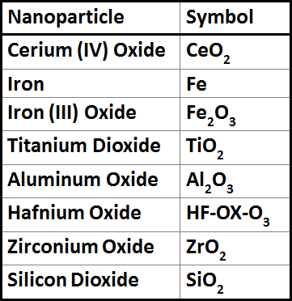
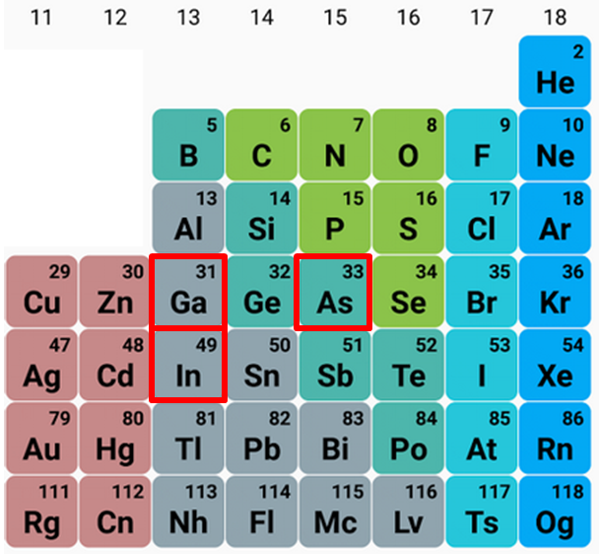
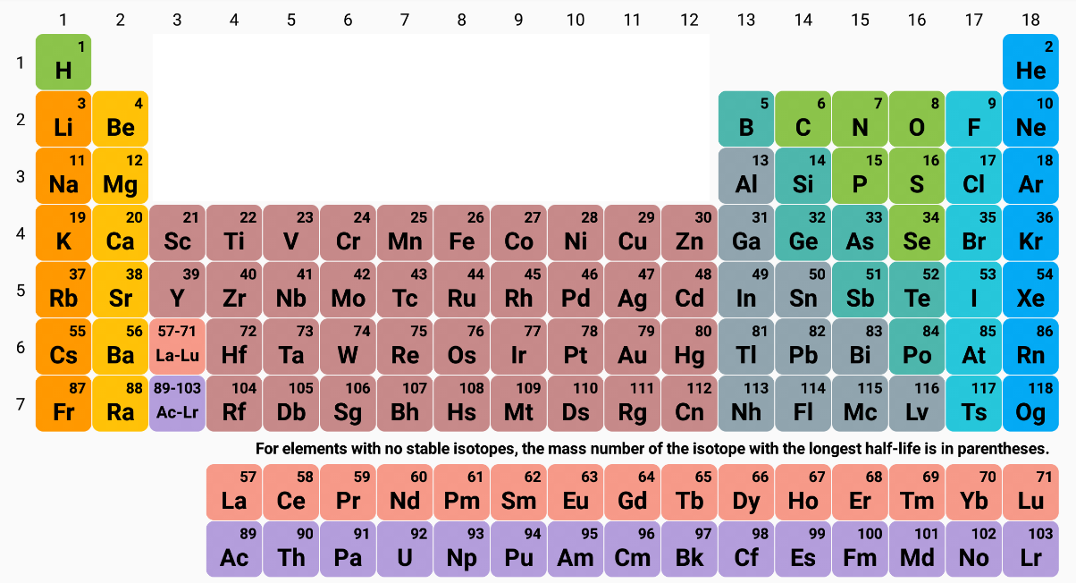
Objective
Determine ENP affinity for:
arsenic(III), gallium(III), and indium(III)
Source: JQ Soft
Source: JQ Soft

Slide 6
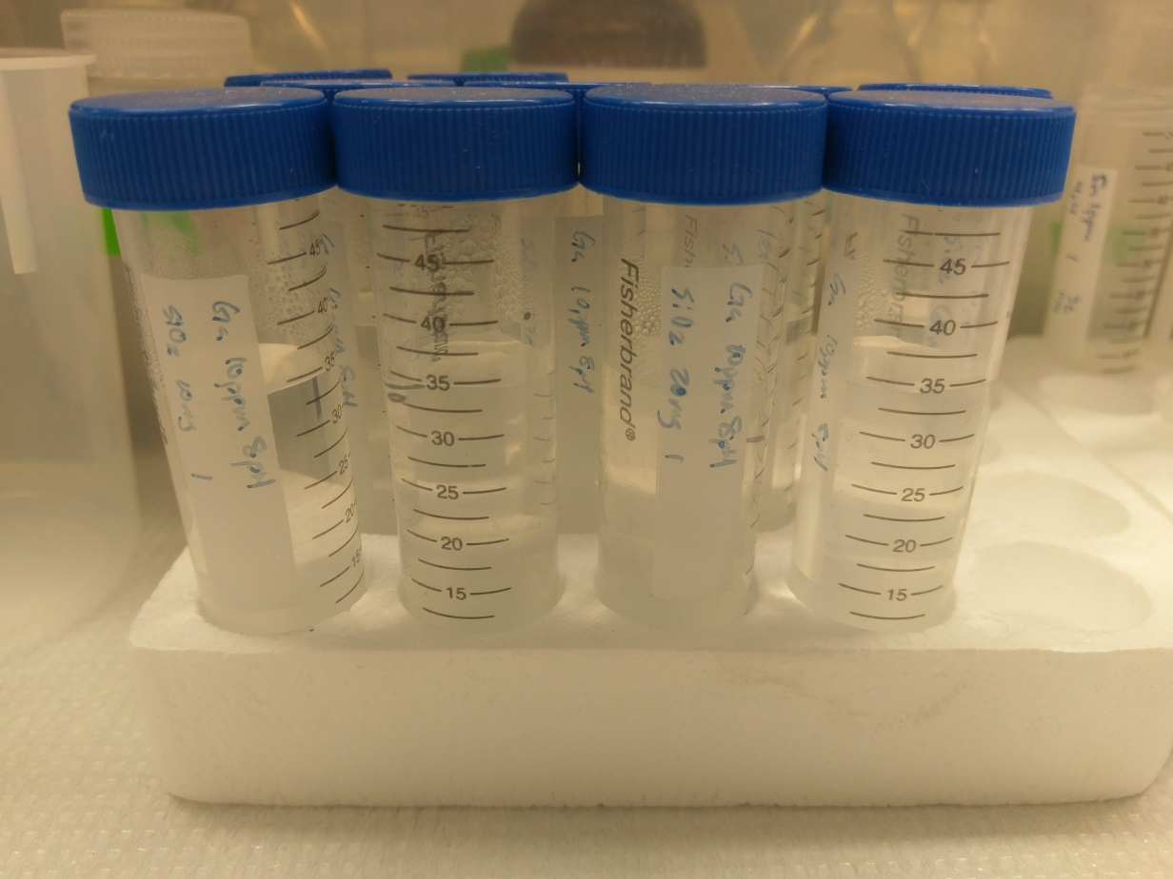
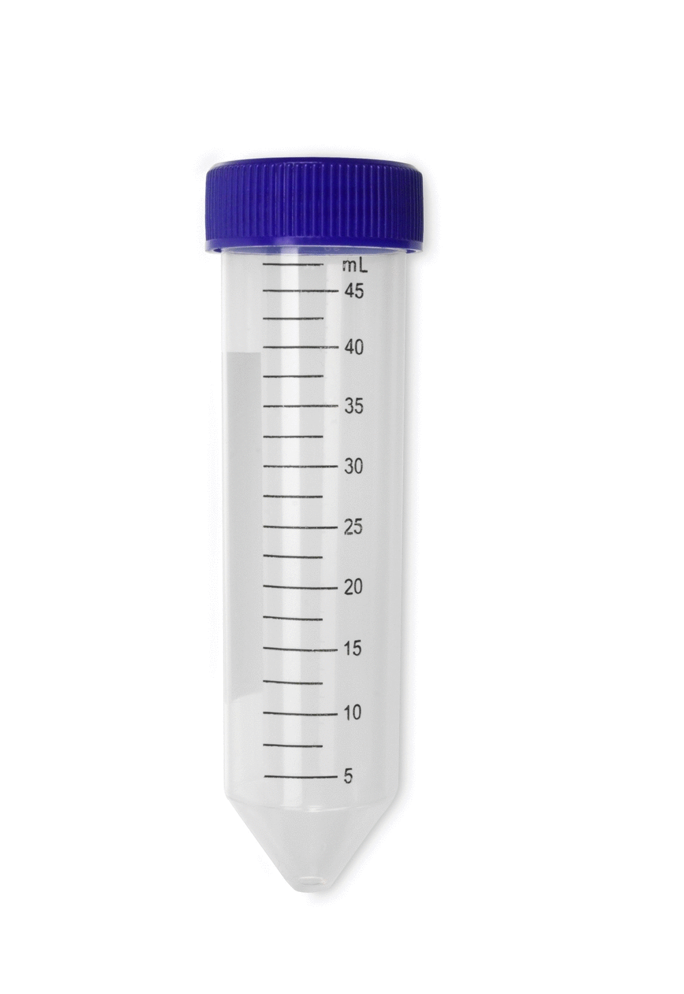
Methods
Kinetics
  Samples were taken over intervals of time
ENP Screening
  Performed with all ENPs
  Two initial concentrations
Adsorption Isotherms
  Measuring a single ENP with one contaminant
  Many initial concentrations
Ambient Air
NaHCO₃
10 mM, 8 pH
Heavy Metal
varying concentrations
ENPs
varying mass
Incubation (shaken, 150 rpm, 23.3°C)

Slide 7
Results
Adsorption onto ENPs occurs rapidly
Future adsorption experiments will be performed for 48 hours

Slide 8
Results
A sufficient amount of ENPs cause complete adsorption of Ga
Gallium was almost fully adsorbed by CeO₂ and SiO₂

Slide 9
Conclusions
The three metals have high affinities for many ENPs
  As(III): CeO₂, Fe, Fe₂O₃
  Ga(III): CeO₂, SiO₂
  In(III): CeO₂, TiO₂
Focus future research on the impact of ENP-metal interactions for ENP fate, toxicity, and remediation

Slide 10
Acknowledgements
Dr. Reyes Sierra
Dr. Chao Zeng
The Arizona/NASA Space Grant Consortium through NASA traineeship grant NNX10AI41H

Slide 11
Thank you

